Slide 1


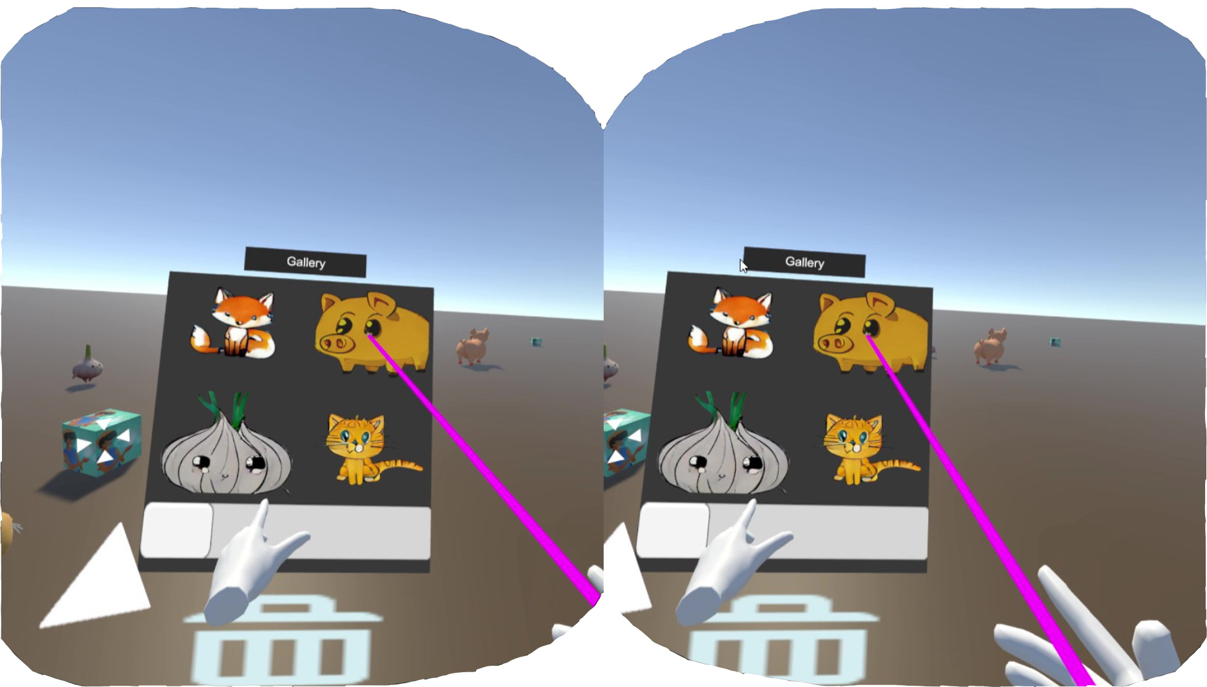
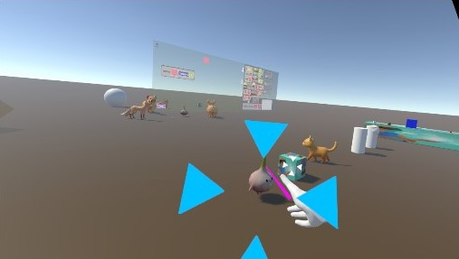
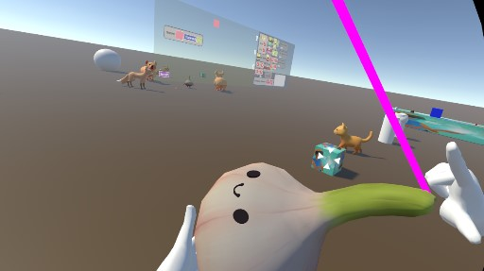

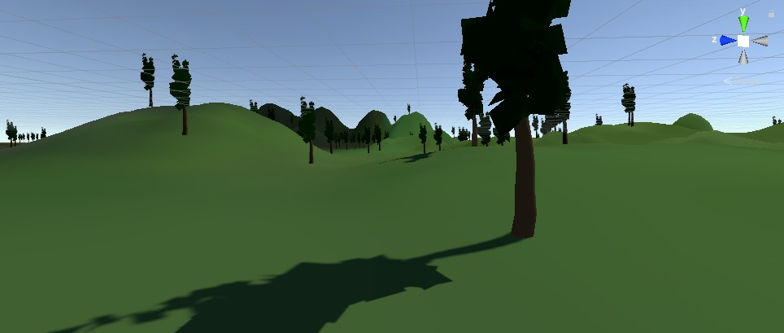
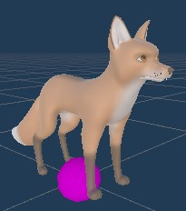
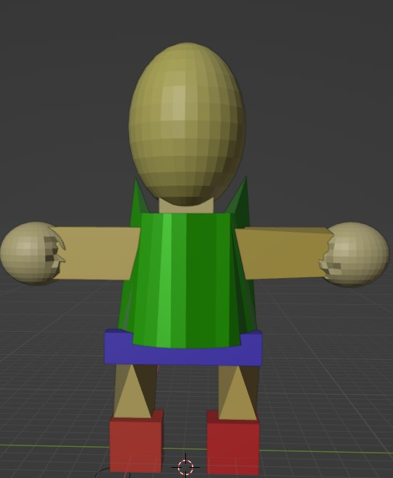
VR Authoring For Everyone
Author: Giovanni Zavalza Mentor: James Vanderhyde
Background
Design
Abstract
Virtual reality (VR) is an exciting field in which one can interact with a 3D environment. The Oculus Quest 2 is a VR device created by Meta that uses a headset and a controller for each hand. Our project allows VR users, no matter their level of experience, to express themselves by creating their own worlds.
Our first decision was to use the newer Oculus Integration Package (OIP) rather than the more documented Unity XR package. Using OIP, a grabbing mechanic was implemented so that objects can be grabbed from a distance. Problems we had to solve involved objects landing sideways and objects being grabbed from unwanted points. To stop objects from landing sideways, we wrote a script to put the center of mass of objects at the base, so they are bottom-heavy like weighted chess pieces. Lastly, we made a gallery to spawn objects into the world. Problems arose when new code didn't work with existing code, but through communication and collaboration, objects both interactable and codable can be spawned.
Abstract
Implementation
Introduction
Overview
Gallery system used to spawn objects into the world. The pink ray points to the object you want to interact with. When the button with a picture of a pig is clicked, a pig is created in the 3D world.
Virtual reality (VR) is an exciting field in which one can interact with a 3D environment. The Oculus Quest 2 is a VR device created by Meta that uses a headset and a controller for each hand. Our project allows VR users, no matter their level of experience, to express themselves by creating their own worlds.
a
In phase one of the project (already completed), authors can use drag-and-drop coding to move objects in the world. Our phase of the project consisted of physical interactions with the objects and a gallery system. We used Unity's Plastic SCM and C# object/data-oriented design. Plastic SCM is a cloud-based public workspace that allows a group to branch, merge, and revert code in a DevOps-like way. C# is the programming language used to create scripts in Unity. The Oculus Integration package was used as a basis for physical interactions between the user and objects within the world. As of today:
Objects can be physically grabbed and moved
Objects can be spawned using a gallery
The interface can be swapped to a "code mode" in which 2D representations of the object can be used in the coding environment
In the future, this will be integrated into computer science classrooms and
open sourced for the public.
Conclusions
Acknowledgements
The blue reticle indicates the object is within grabbing distance, and white shows object is too far.
The user has grabbed the object and can now interact with it physically.
Results
Methods
Conclusions
Acknowledgements
As of today, we have:
Drag-and-drop coding
Gallery system
Physical interactions
In-progress features:
A tutorial system
Terrain generation
Avatar import
Abstract
If we had more time, we would create...
An object creation system so users can add to the virtual environment freely
Make the project open source so any programmer, artist, designer, etc. can add to the program
Test the program in a beginning CS classroom to see how effective a VR environment is for learning CS logic
This project is funded by Elmhurst University through the PUMA-STEM Summer Research Program.
This work is supported by the National Science Foundation through the LSAMP Program under Award Number 1911271. Any opinions, findings, and conclusions or recommendations expressed in this material are those of the author(s) and do not necessarily reflect the views of the National Science Foundation.
Terrain
generation visual
Dollhouse fox model
<--
Blender model
<--
Photos in gallery system were generated by the ai-art-generating tool Craiyon.

